Slide 1

BY: R. LAVANYA
23P31A4436
CSE-DATA SCIENCE
ADITYA COLLEGE OF ENGINEERING AND TECHNOLOGY

Slide 2
PROBLEM STATEMENT:
The Stock Info – Real-Time Stock Analysis system addresses the challenge of constantly changing stock prices by providing investors with instant, data-driven insights. In fast-moving markets, delayed information can lead to poor investment decisions and missed opportunities. This system continuously tracks live-stock data, detects volatility, and sends real-time alerts when prices cross defined thresholds. By ensuring timely updates and actionable insights, Stock-Info empowers investors to stay ahead of market trends and make informed financial decisions.

Slide 3
Objectives
To monitor live-stock market data and provide real-time updates to investors.
To detect and alert users instantly when stock prices cross predefined thresholds.
To help investors make quick, data-driven decisions and minimize financial risks.
To enhance user experience through automated insights and personalized notifications.
To ensure accuracy, reliability, and speed in stock data tracking and alert generation.
Scope
1.The system will collect and process real-time stock market data from various online financial sources or APIs.
2. It will allow users to track selected stocks and set custom price thresholds for alerts.
3.The platform will generate instant notifications (via web, email, or mobile) when stock prices fluctuate beyond set limits.
4. It will include data visualization features like live charts, trend analysis, and performance dashboards.
5. The system can be expanded to support predictive analytics using machine learning for forecasting stock trends.
6.It is designed for use by individual investors, financial analysts, and institutions seeking automated market insights.

Slide 4
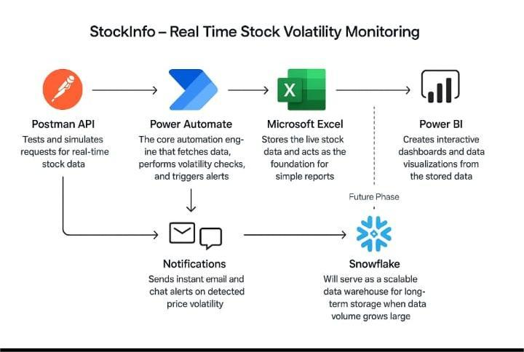
TECHNOLOGY USED TO BUILD THE PROJECT:
Postman: Used to test and simulate real-time API requests to fetch stock data.
Microsoft Power Automate: Automates the process of collecting, processing data, and triggering alerts.
SharePoint: Stores and manages structured data in lists for easy access and integration.
Microsoft Excel: Organizes and maintains the stock data for further analysis.
Microsoft Power BI: Creates interactive dashboards to visualize and analyze the data effectively.

Slide 5





System Architecture: From Data to Decision
Watchlist Management
Automated Data Fetch
Our robust architecture leverages Power Automate to fetch real-time stock data from the Alpha Vantage API. This data is then compared against user-defined volatility thresholds in a SharePoint-managed watchlist. Significant price movements trigger automated email notifications, while all data is seamlessly integrated into Excel for dynamic visualization and in-depth analysis.
External API Integration
Threshold Monitoring
Dynamic Visuals

Slide 6



Immediate Impact
Strategic Enhancements
Instant Volatility Alerts
Snowflake Integration
Users receive real-time notifications on significant stock
price fluctuations.
Enabling advanced analytics with historical stock data storage.
Centralized Data Management
Power BI Visualizations
SharePoint offers a secure and accessible platform for watchlists and stock data.
Introducing richer, real-time dashboards and predictive trend analysis.
Interactive Analysis
Mobile-Friendly Alerts
Excel dashboards provide dynamic visualization for informed decision-making.
Expanding notifications to Teams or SMS for on-the-go accessibility.

Slide 7
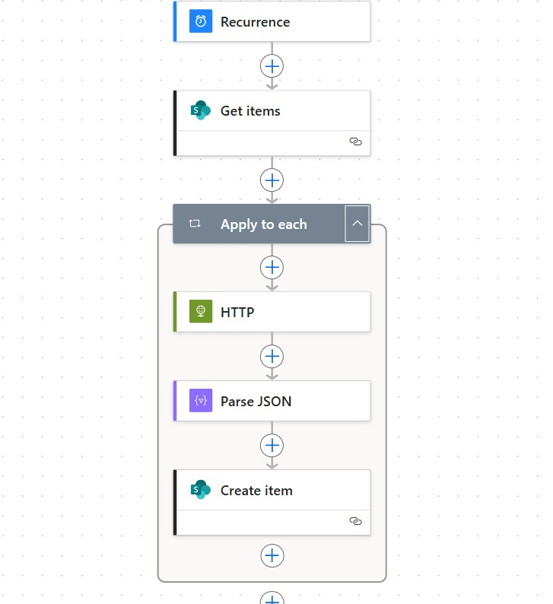

POWER AUTOMATE
FLOW:

Slide 8

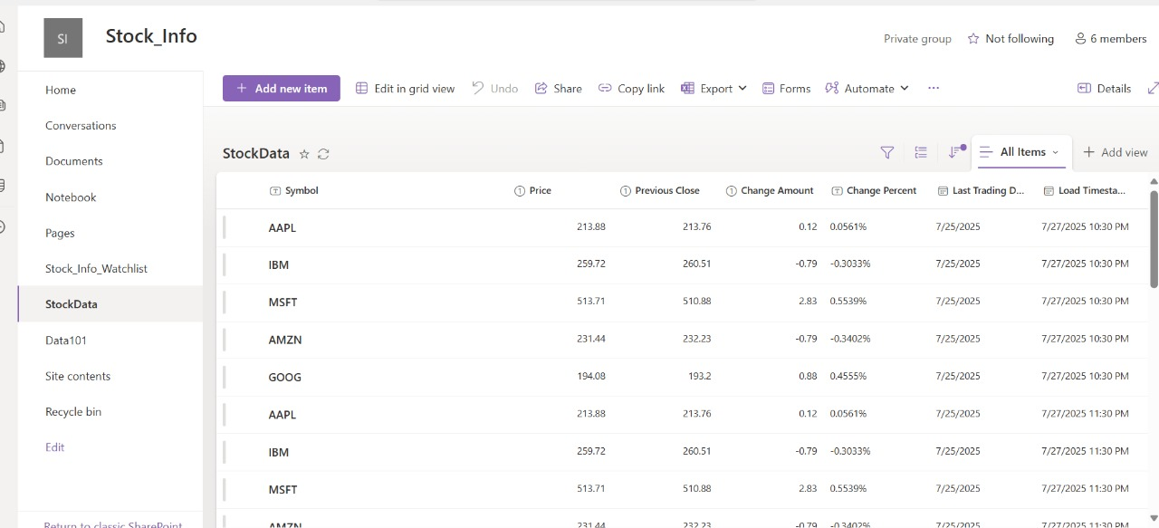
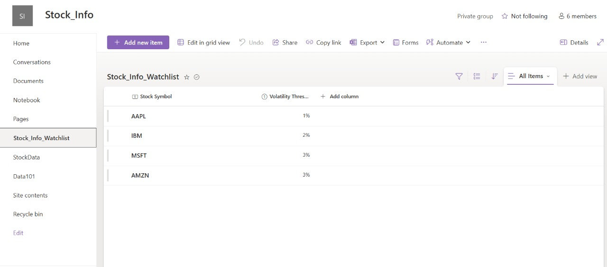
SHARE POINT LISTS:

Slide 9
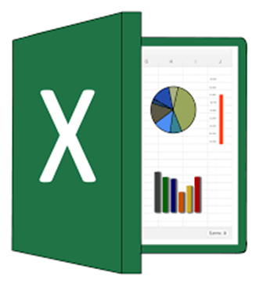
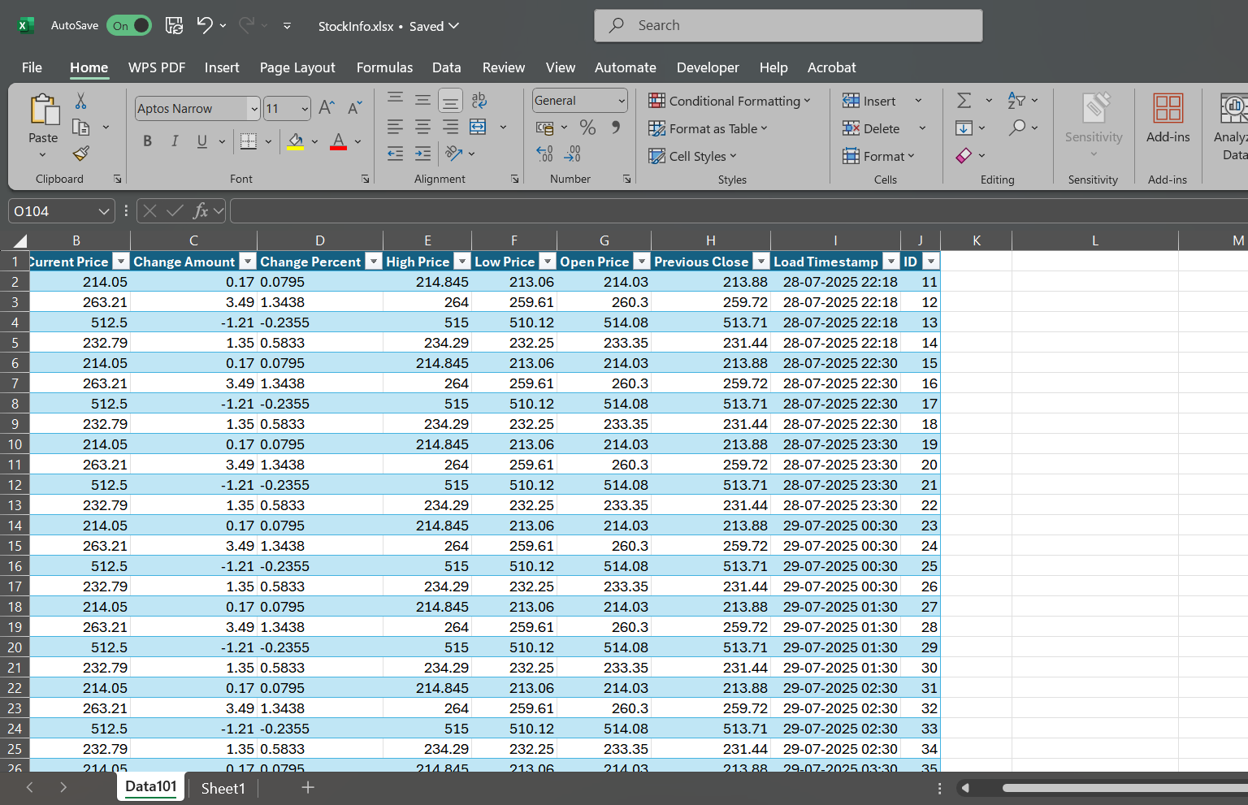
EXCEL:

Slide 10

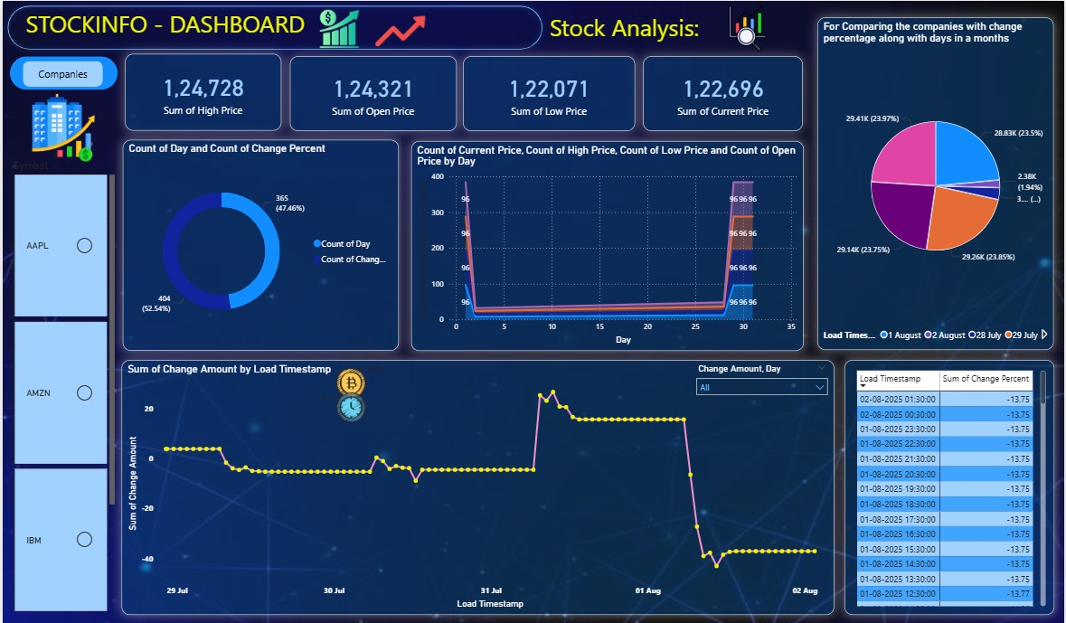
DASHBOARD:

